Slide 1
Mass-Storage Systems

Slide 2
https://codegyan.in/linux-terminal-online.php
Linux terminal online

Slide 3
Mass-Storage Systems: What to Learn
Structure of mass-storage devices and the resulting effects on the uses of the devices
  Hard Disk Drive
  SSD (Solid-state drive)
  Hybrid Disk
Performance characteristics and management of mass-storage devices
  Disk Scheduling
RAID –(originally redundant array of inexpensive disks; now commonly redundant array of independent disks) is a data storage virtualization technology that combines multiple disk drive components into a single logical unit for the purposes of data redundancy or performance improvement.
  improve performance/reliability

Slide 4
Overview of Mass Storage Structure
Bulk of secondary storage for modern computers is hard disk drives (HDDs) and nonvolatile memory (NVM) devices
HDDs spin platters of magnetically-coated material under moving read-write heads
  Drives rotate at 60 to 250 times per second
  Transfer rate is rate at which data flow between drive and computer
  Positioning time (random-access time) is time to move disk arm to desired cylinder (seek time) and
  time for desired sector to rotate under the disk head (rotational latency)
  Head crash results from disk head making contact with the disk surface -- That’s bad
Disks can be removable

Slide 5

The First Commercial Disk Drive
1956
IBM RAMDAC computer included the IBM Model 350 disk storage system
5M (7 bit) characters
50 x 24” platters
Access time = < 1 second

Slide 6
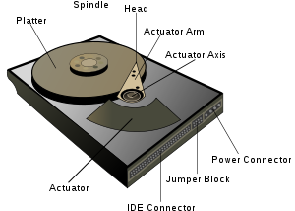

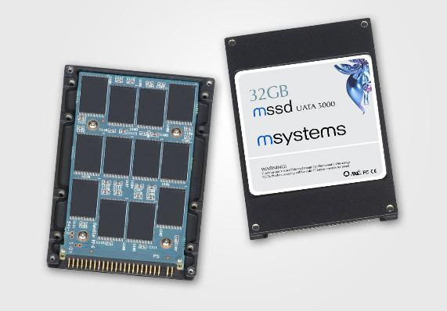
Mass Storage: HDD and SSD
Most popular: Magnetic hard disk drives
Solid state drives: (SSD)

Slide 7
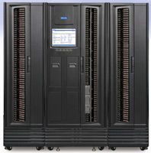
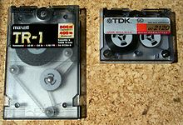
Magnetic Tape
Relatively permanent and holds large quantities of data
Random access ~1000 times slower than disk
Mainly used for backup, storage of infrequently-used data, transfer medium between systems
20-1.5TB typical storage
Common technologies are 4mm, 8mm, 19mm, LTO-2 and SDLT

Slide 8
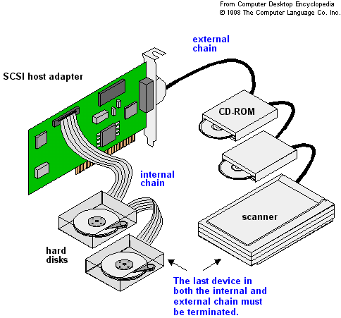
Disk Attachment
Drive attached to computer via I/O bus
USB-Universal Serial Bus
SATA Serial Advanced Technology Attachment (replacing ATA, PATA, EIDE (Enhanced Integrated Drive Electronics))
SCSI
  itself is a bus, up to 16 devices on one cable, SCSI initiator requests operation and SCSI targets perform tasks
FC (Fiber Channel) is high-speed serial architecture
  Can be switched fabric with 24-bit address space – the basis of storage area networks (SANs) in which many hosts attach to many storage units

Slide 9
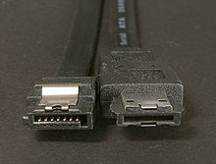
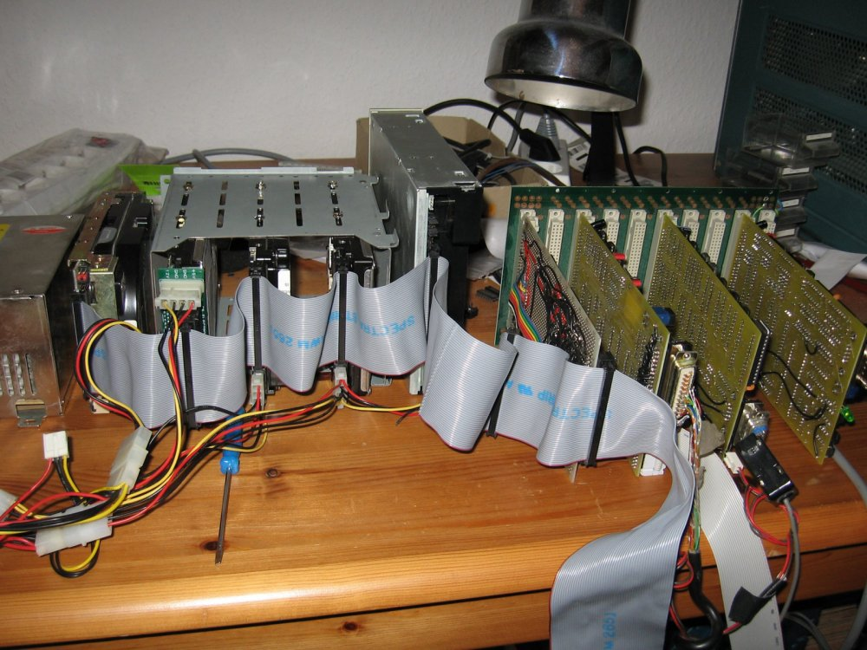
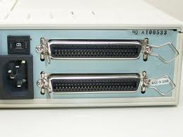
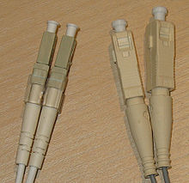

SATA connectors
SCSI
FC with SAN-switch

Slide 10

Network-Attached Storage
Network-attached storage (NAS) is storage made available over a network rather than over a local connection (such as a bus)
NFS(Network File System) and CIFS (Common Internet File System)are common protocols
Implemented via remote procedure calls (RPCs) between host and storage
New Iscsi ( Internet Small Computer System Interface) protocol uses IP network to carry the SCSI protocol

Slide 11
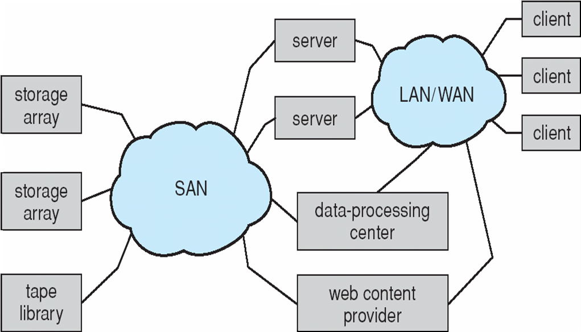
Storage Area Network (SAN)
Special/dedicated network for accessing block level data storage
Multiple hosts attached to multiple storage arrays - flexible

Slide 12
Performance characteristics of disks
Drives rotate at 60 to 200 times per second
Positioning time is
  time to move disk arm to
  desired cylinder (seek time)
  plus time for desired sector to rotate
  under the disk head (rotational latency)
Transfer rate: data flow speed between drive and computer
  Sustained bandwidth: “average data transfer rate during a large transfer– that is the, number of bytes divided by transfer time”
    data rate without positioning time
  Effective bandwidth: average transfer rate including positioning time

Slide 13
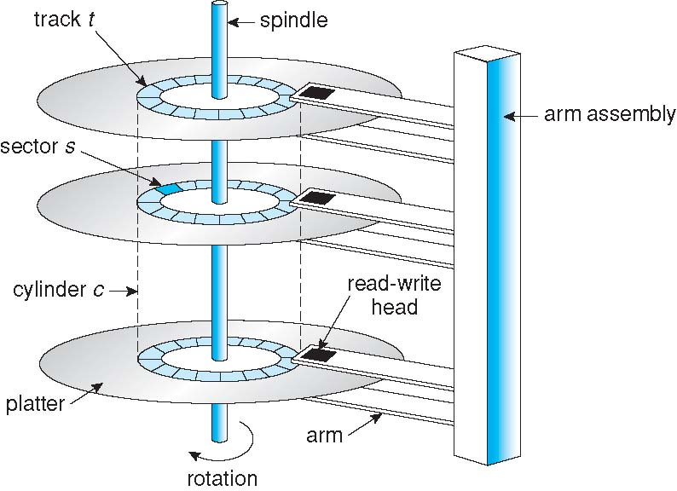
Moving-head Disk Mechanism

Slide 14
Disk Scheduling: Objective
Given a set of IO requests
Coordinate disk access of multiple I/O requests for faster performance and reduced seek time.
  Seek time ≈ seek distance
  Measured by total head movement in terms of cylinders from one request to another.
Hard Disk
Drive

Slide 15

FCFS (First Come First Serve)
total head movement: 640 cylinders for executing all requests

Slide 16
FCFS
Advantages:
Every request gets a fair chance
No indefinite postponement
Disadvantages:
Does not try to optimize seek time
May not provide the best possible service

Slide 17

SSTF (Shortest Seek Time First)
Selects the request with the minimum seek time from the current head position
total head movement: 236 cylinders

Slide 18
SSTF
Advantages:
Average Response Time decreases
Throughput increases
Disadvantages:
Overhead to calculate seek time in advance
Can cause Starvation for a request if it has higher seek time as compared to incoming requests
High variance of response time as SSTF favours only some requests

Slide 19

SCAN: Elevator algorithm
The disk arm starts at one end of the disk, and moves toward the other end, servicing requests until it gets to the other end of the disk, where the head movement is reversed and servicing continues.
total head movement : 208 cylinders

Slide 20
SCAN
Advantages:
High throughput
Low variance of response time
Average response time
Disadvantages:
Long waiting time for requests for locations just visited by disk arm

Slide 21

C-SCAN (Circular-SCAN)
Provides a more uniform wait time than SCAN by treating cylinders as a circular list.
The head moves from one end of the disk to the other, servicing requests as it goes. When it reaches the other end, it immediately returns to the beginning of the disk, without servicing any requests on the return trip

Slide 22
C-SCAN
Advantages:
Provides more uniform wait time compared to SCAN

Slide 23
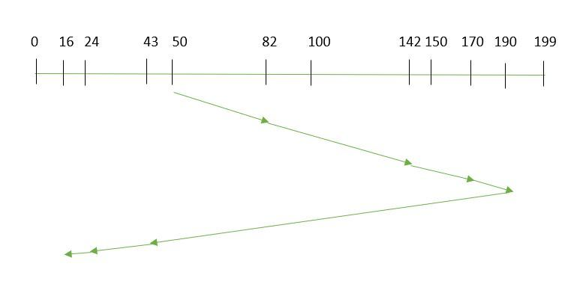
LOOK
It is similar to the SCAN disk scheduling algorithm except for the difference that the disk arm in spite of going to the end of the disk goes only to the last request to be serviced in front of the head and then reverses its direction from there only. Thus it prevents the extra delay which occurred due to unnecessary traversal to the end of the disk.

Slide 24

C-LOOK: A version of C-Scan
Arm only goes as far as the last request in each direction, then reverses direction immediately, without first going all the way to the end of the disk

Slide 25
Scheduling Algorithms
Algorithm Name | Description
FCFS | First-come first-served
SSTF | Shortest seek time first; process the request that reduces next seek time
SCAN (aka Elevator) | Move head from end to end (has a current direction)
C-SCAN | Only service requests in one direction (circular SCAN)
LOOK | Similar to SCAN, but donot go all the way to the end of the disk.
C-LOOK | Circular LOOK. Similar to C-SCAN, but donot go all the way to the end of the disk.
Notes:
SCAN (dumb elevator): Back and forth, to end/start track
C-: Circular: Only process requests in one direction
LOOK: Only go as far as last request

Slide 26
Selecting a Disk-Scheduling Algorithm
Either SSTF or C-LOOK is a reasonable choice for the default algorithm
  SSTF is common with its natural appeal (but it may lead to starvation issue).
  C-LOOK is fair and efficient
  SCAN and C-SCAN perform better for systems that place a heavy load on the disk
Performance depends on the number and types of requests

Slide 27
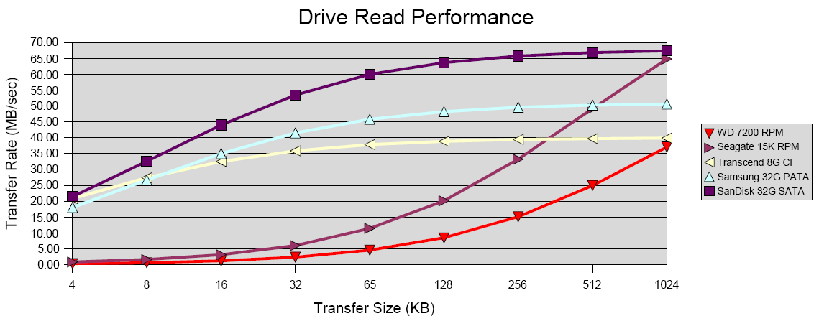
Drive read performance

Slide 28
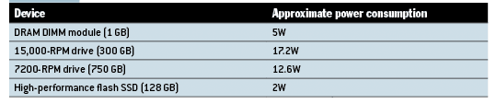
Power consumption

Slide 29

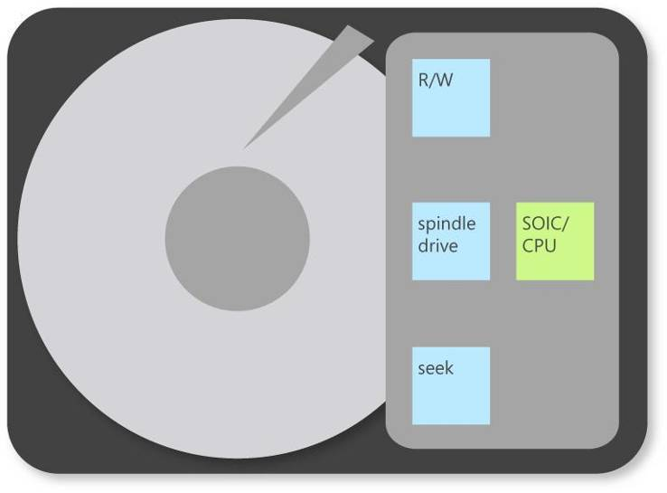
Hybrid Disk Drive
A hybrid disk uses a small SSD as a buffer for a larger drive
All dirty blocks can be flushed to the actual hard drive based on:
  Time, Threshold, Loss of power/computer shutdown
Dram
Cache
ATA Interface
Add a non-volatile cache
NV
Cache

Slide 30
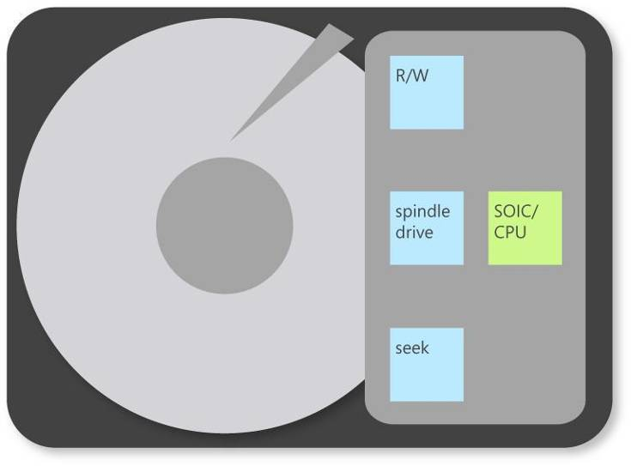
Hybrid Disk Drive Benefits
Dram
Cache
Up to 90% Power Saving
when powered down
ATA Interface
Read and Write instantly while spindle stopped
NV
Cache

Slide 31
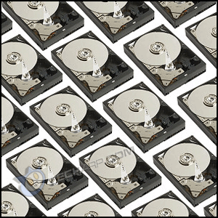
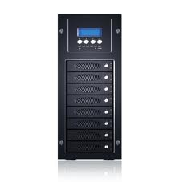
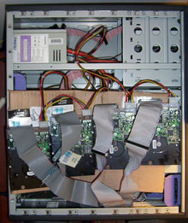
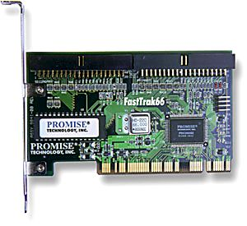
RAID (Redundant Array of Inexpensive Disks)
Multiple disk drives provide reliability
via redundancy.
Increases the mean time to failure
Hardware RAID and software RAID

Slide 32
RAID (Cont.)
RAID
  multiple disks work cooperatively
  Improve reliability by storing redundant data
  Improve performance with disk striping (use a group of disks as one storage unit)
RAID is arranged into six different levels
  Mirroring (RAID 1) keeps duplicate of each disk
  Striped mirrors (RAID 1+0) or mirrored stripes (RAID 0+1) provides high performance and high reliability
  Block interleaved parity (RAID 4, 5, 6) uses much less redundancy

Slide 33
RAID
Redundant Array of Independent Disks
Set of physical disk drives viewed by the operating system as a single logical drive
Data are distributed across the physical drives of an array
Redundant disk capacity is used to store parity information which provides recoverability from disk failure
Disk striping is the process of dividing a body of data into blocks and spreading the data blocks across multiple storage devices, such as hard disks or solid-state drives (SSDs).
Notes:
Movie icon links to animation at: http://gaia.ecs.csus.edu/%7ezhangd/oscal/RAIDFiles/RAID.htm
The RAID scheme consists of seven levels, zero through six.
These levels do not imply a hierarchical relationship but designate different design architectures that share three common characteristics:
1. RAID is a set of physical disk drives viewed by the operating system as a single logical drive.
2. Data are distributed across the physical drives of an array in a scheme known as striping, described subsequently.
3. Redundant disk capacity is used to store parity information, which guarantees data recoverability in case of a disk failure.

Slide 34
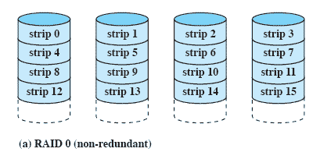
RAID 0 - Stripped
RAID 0 consists of striping, but no mirroring or parity.
Not a true RAID – no redundancy
This configuration has striping but no redundancy of data
Disk failure is catastrophic
Very fast due to parallel read/write
Notes:
RAID level 0 is not a true member of the RAID family, because it does not include redundancy.
The advantage of this layout is that if a single I/O request consists of multiple logically contiguous strips, then up to n strips for that request can be handled in parallel, greatly reducing the I/O transfer time.

Slide 35
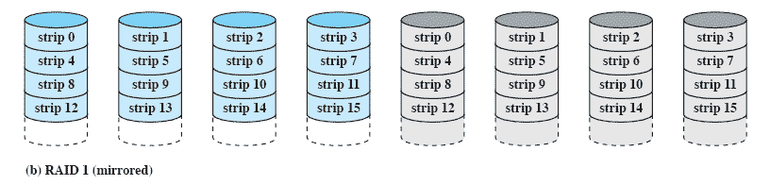
RAID 1 - Mirrored
RAID 1 consists of data mirroring, without parity or striping.
Redundancy through duplication instead of parity.
Read requests can made in parallel.
Simple recovery from disk failure
Notes:
each logical strip is mapped to two separate physical disks so that every disk in the array has a mirror disk that contains the same data.
A read request can be serviced by either of the two disks that contains the requested data, whichever one involves the minimum seek time plus rotational latency.
A write request requires that both corresponding strips be updated, but this can be done in parallel.
Thus, the write performance is dictated by the slower of the two writes
Recovery from a failure is simple.
When a drive fails, the data may still be accessed from the second drive.

Slide 36
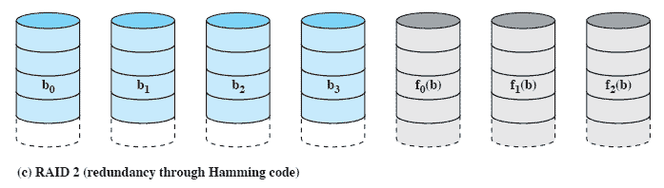
RAID 2 (Using Hamming code)
In computer science and telecommunication, Hamming codes are a family of linear error-correcting codes. Hamming codes can detect up to two-bit errors or correct one-bit errors without detection of uncorrected errors
RAID 2 consists of bit-level striping with dedicated Hamming-code parity
Synchronised disk rotation
Data stripping is used (extremely small)
Hamming code used to correct single bit errors and detect double-bit errors
Notes:
In a parallel access array, all member disks participate in the execution of every I/O request.
Typically, the spindles of the individual drives are synchronized so that each disk head is in the same position on each disk at any given time.
As in the other RAID schemes, data striping is used.
In the case of RAID 2 and 3, the strips are very small, often as small as a single byte or word.
With RAID 2, an error-correcting code is calculated across corresponding bits on each data disk, and the bits of the code are stored in the corresponding bit positions on multiple parity disks.
Typically, a Hamming code is used, which is able to correct single-bit errors and detect double-bit errors.

Slide 37
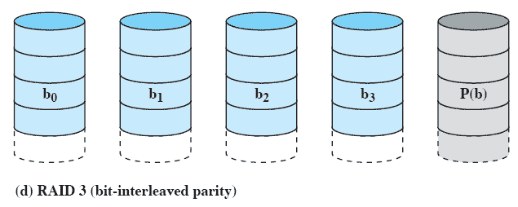
RAID 3 (bit-interleaved parity)
RAID 3 consists of byte-level striping with dedicated parity
Similar to RAID-2 but uses all parity bits stored on a single drive
Notes:
RAID 3 is organized in a similar fashion to RAID 2.
The difference is that RAID 3 requires only a single redundant disk, no matter how large the disk array.
RAID 3 employs parallel access, with data distributed in small strips.
Instead of an error-correcting code, a simple parity bit is computed for the set of individual bits in the same position on all of the data disks.

Slide 38
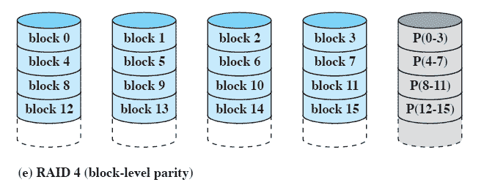
RAID 4 (Block-level parity)
RAID 4 consists of block-level striping with dedicated parity
A bit-by-bit parity strip is calculated across corresponding strips on each data disk
The parity bits are stored in the corresponding strip on the parity disk.
Notes:
A bit-by-bit parity strip is calculated across corresponding strips on each data disk,
and the parity bits are stored in the corresponding strip on the parity disk.

Slide 39
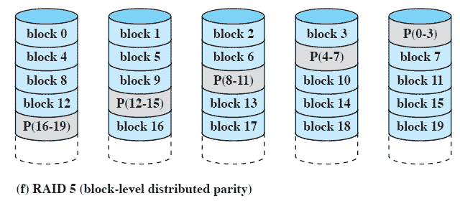
RAID 5 (Block-level Distributed parity)
RAID 5 consists of block-level striping with distributed parity.
Similar to RAID-4 but distributing the parity bits across all drives
Notes:
RAID 5 is organized in a similar fashion to RAID 4.
RAID 5 distributes the parity strips across all disks.
A typical allocation is a round-robin scheme
For an n-disk array, the parity strip is on a different disk for the first n stripes, and the pattern then repeats.
The distribution of parity strips across all drives avoids the potential I/O bottleneck of the single parity disk found in RAID 4.

Slide 40
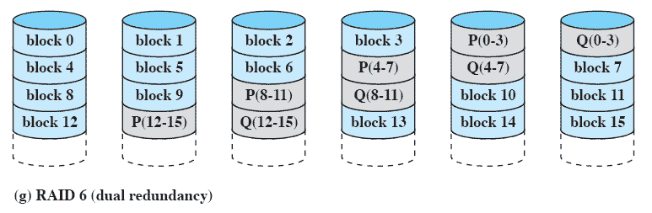
RAID 6 (Dual Redundancy)
RAID 6 consists of block-level striping with double distributed parity
Two different parity calculations are carried out
  stored in separate blocks on different disks.
Can recover from two disks failing
Notes:
Two different parity calculations are carried out and stored in separate blocks on different disks.
Thus, a RAID 6 array whose user data require N disks consists of N+2 disks.
P and Q are two different data check algorithms.
One of the two is the exclusive-OR calculation used in RAID 4 and 5.
The other is an independent data check algorithm.
This makes it possible to regenerate data even if two disks containing user data fail.

Slide 41
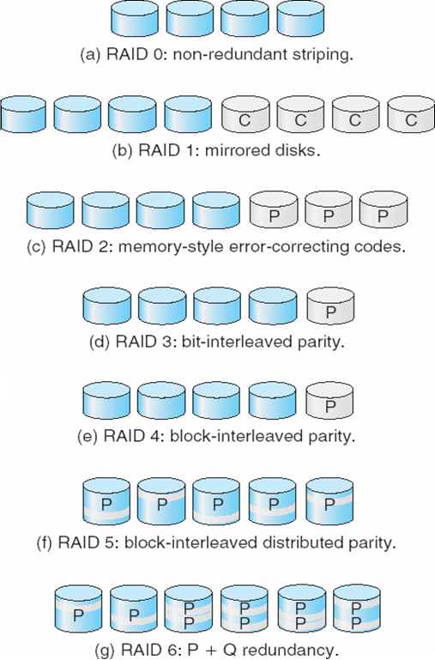
6 RAID Levels

